Slide 1
SGML and XML
Text Encoding and Markup Languages
Michael Popham
michael.popham@oucs.ox.ac.uk

Slide 2
Overview (Welcome to acronym hell)
The Oxford Text Archive and Arts and Humanities Data Service
Markup languages
SGML: development and features
XML Activity at the W3C
Why does all this matter?
Notes:
This can only be a taster, too much to cover (see resources at end)

Slide 3
Arts & Humanities Data Service
AHDS
Executive
KCL
ADS
HDS
OTA
PADS
VADS
York
Essex
Oxford
Glasgow
Surrey Inst.
http://ahds.ac.uk

Slide 4
Markup languages
A markup language is a set of conventions governing the use of markup
These rules typically state
  what kinds of markup are allowed or required
  where they are allowed or required
  how they relate to each other
  how to distinguish markup from content (the text itself)
Notes:
Summary of what you’ve already learned.

Slide 5
Is all markup interchangeable?
<C 1>Loomings
\chapter
\chapter[1]{Loomings}
:h1.1. Loomings
.chapter Loomings
.cp;.sp 6 a;.ce .bd 1. Loomings
~x
<div type=chapter n=1><head>Loomings</head>
Notes:
Apparently not!!

Slide 6
SGML = ISO 8879
An ISO standard for the definition of markup languages
Markup
  a method of making explicit (and therefore processable) interpretations of a text
Markup language
  a set of defined codes and rules for specifying markup
Notes:
ISO = International Standards Organization
ISO 8879 contains precise definitions of all the major markup concepts relevant to SGML

Slide 7
An SGML document
SGML Declaration (techie stuff)
Document Type Definition (DTD)
Document instance (document)
  Elements
  Attributes
  Entities

Slide 8
Putting it all together
SGML Declaration
Intended for “human” readers
DOCTYPE Declaration
+ optional, local extensions
Document Instance
The text itself
(content+markup)

Slide 9
SGML is a metalanguage
SGML/XML
ISO/W3C
DTD DTD DTD
A.N.Other
docs docs
docs docs docs
docs docs
Users
Notes:
SGML (and XML) is used to define other markup languages, expressed as Document Type Definitions.
Each DTD can then be used to control the application of markup in a document instance

Slide 10
SGML DTDs
SGML
HTML
TEI
ISO12083
docs docs
docs docs docs
docs docs
Notes:
The markup rules expressed in an SGML DTD are checked by a validating parser – which should mean no problems or surprises for the processing/receiving application.

Slide 11
A newspaper story
Elements
  A story consists of data fields, followed by a headline, and then paragraphs containing sentences of character data, names etc.
Attributes
  It also has an identifier, a date, section etc.
Entities
  Represent boilerplate info., special characters etc.
NB: we’re saying nothing about what the elements look like, only what they are
Notes:
This is not intended to be an exhaustive example!
Style/presentational information is not something which concerns us at this point.

Slide 12
A simple(!) SGML DTD
<!ELEMENT story - o ((%data;), title, p+)>
<!ATTLIST story id ID #REQUIRED
date CDATA #REQUIRED
section CDATA #IMPLIED>
<!ELEMENT title - - (#PCDATA)>
<!ELEMENT p - o ((#PCDATA |q |name)+)>
<!ELEMENT name - - (#PCDATA) >
<!ATTLIST name type (person|place|org|any) any
reg CDATA #IMPLIED >
<!ENTITY % data “(author+, location?, keywords)>
<!ELEMENT author - - (surname, firstname?)>
<!ELEMENT surname - - (#PCDATA) >
<!ELEMENT firstname - - (#PCDATA)>
<!ENTITY ManU “Manchester United” >
<!ENTITY SAF “Sir Alex Ferguson” >
…
Notes:
Again, this is meant to be representative (it wouldn’t be accepted by SGML/XML software!)

Slide 13
An SGML instance
<story id=7809 date=2000-02-22 section=sport>
<data> <author><surname>Taylor</surname>
<firstname>Daniel</firstname></author> <location>Manchester</location> <keywords>Beckham, Posh Spice, Manchester United, childcare, Sir Alex Ferguson</keywords> </data>
<title>&ellipsis; but the spin may not wash with Ferguson</title>
<p><name type=“person” reg=“BeckhamD”>David Beckham</name>’s advisers claimed yesterday that he had <q>been given no reason whatsoever</q> for being banished from training and dropped from <name type=“org” reg=“ManU”>&ManU;</name>’s first-team after incurring the wrath of his manager <name type=“person” reg=“FergusonA”>&SAF;</name></p>
<p>As <name type=“person” reg=“BeckhamD”>Beckham</name> attempted to focus on…</p>
</story>
Notes:
RED = Elements
BLUE = Attributes on elements
YELLOW = Entities

Slide 14
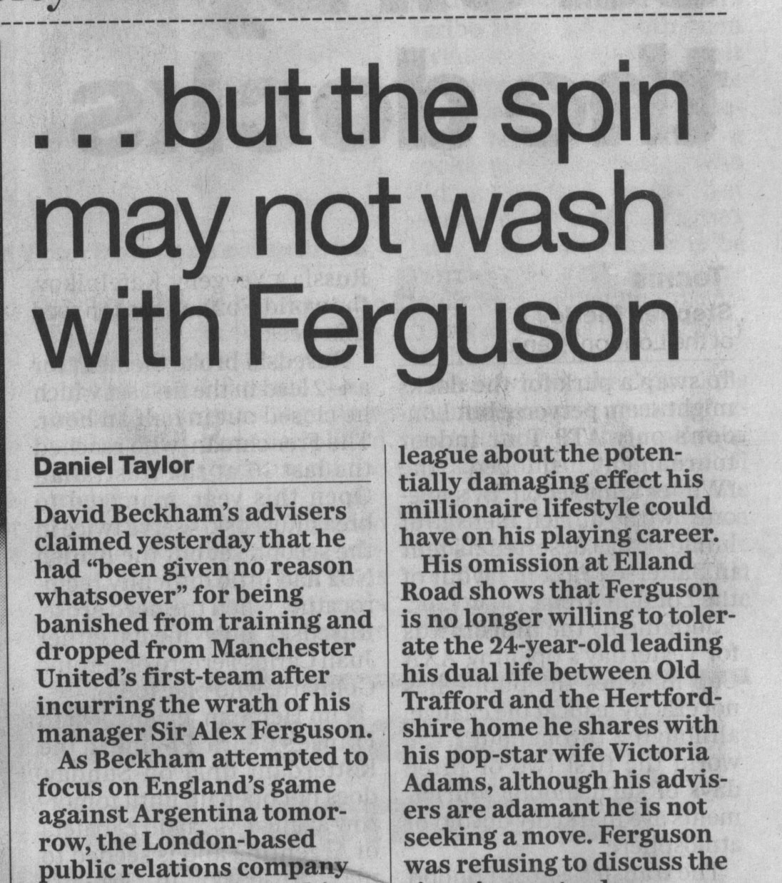
The formatted view

Slide 15
Defining an Element
Omissibility
element name or GI
content model
<!ELEMENT p - o ((#PCDATA|q|name)+)>
<!ELEMENT name - - (#PCDATA) >

Slide 16
Elements may take attributes
Providing information other than type or context
Useful for identification of element occurrences
Limited data validation
attribute name
attribute value
<P><NAME TYPE="person" REG="BeckhamD"> David Beckham</name>’s advisers claimed yesterday that he had… </S>

Slide 17
Documents: another view
Documents are made up of entities
Entities are named units of storage, using an associated notation
Entities can be…
  A single character or symbol (or a string of these)
  Another file (e.g. text, image, sound, video etc.)
  Something on the Web

Slide 18
Like HTML, XML must...
Be usable on the net (but not restricted to it!)
Support a wide variety of applications
Be compatible with SGML
Be easy to process
Have few optional features (ideally none)
Be human-legible and reasonably clear
Be specified in a way that is both formal and concise
Notes:
XML = HTML++ ?

Slide 19
Unlike HTML...
XML is an extensible markup language
XML markup can be verified
XML markup reflects the meaning of your data, not its appearance
Notes:
XML is the foundation of a family of related standards

Slide 20
XML cf. SGML— differences
  No tag omission/minimization
  Properly delimited comments
  No inclusions/exclusions
  Mixed content models
    optional-repeatable OR-groups with #PCDATA first
  No & in content model groups
  Simpler rules for handling whitespace
  Empty tags use new syntax <empty/>
Notes:
Need to know SGML in-depth to appreciate many of these issues. Essentially, they’re all the things that make developing SGML systems and processing SGML data difficult – and therefore expensive – to do.

Slide 21
How do they really differ?
Pre-/Post- the success of the Web
Ease-of-implementation and use
Greater raw computing power on the desktop
“XML is what SGML should have been”
More tools, more books, easier to learn
Notes:
SGML was ahead of it’s time – but also perhaps constrained in its conception by the processing power available in the mid-/late-80s

Slide 22
XML Activity at W3C
  XML Applications
    Resource Description Framework (RDF), Synchronized Multimedia Integration Language (SMIL), XHTML
  Extensible Stylesheet Language (XSL)
    XSL Transformation Language, XSL Formatting Objects
  XML Linking Language(Xlink) and XML Pointer Language (Xpointer)
  XML Schema, namespaces
Notes:
RDF = a simple way of modelling metadata about web resources and the relationships between them (to improve automatic processing, search and retrieval etc.)
SMIL = based on HyTime concepts. Synchronizing multimedia is important when delivering on different platforms and in different environments (e.g. high-end desktop and WAP phone)
XHTML = an XML conformant implementation of HTML
XSL etc. = gaining real control of the presentation of data (especially important for publishers of all types)
XML Linking = essential for robust and improved hyperlinking on the web
XML Schema = replacing XML’s reliance on SGML DTDs, allowing for better handling of attributes, data-typing etc.
Namespaces = to get around the problem of sharing/combining/reusing data developed according to different DTDs/Schema which use the same element names for different things (e.g. postal address vs network address, title of a person vs title of a publication etc).

Slide 23
Why does this matter?
The XML revolution (hype?)
XML = big names
XML means application independence for your data
XML means shareable, reusable data
Improved data longevity(?)
Notes:
Big names = Microsoft, Netscape, Sun, etc. etc.
Improved longevity = vital if we are not to lose the vast intellectual and monetary effort that is being put into creating today’s digital resources. Although digital data has the tremendous advantage of being easy and cheap to reproduce, if that data is ultimately unreadable (and therefore inaccessible) it is less likely to survive for future generations that stone tablets, papyrii, velum manuscripts, acid-free paper etc.

Slide 24
Further information
The SGML/XML web page
  http://www.oasis-open.org/cover/
W3C’s XML web page
  http://www.w3.org/XML/
The Text Encoding Initiative
  http://www.tei-c.org/
…and even
  “XML: the future of web markup?” by Elliott Pritchard at http://panizzi.shef.ac.uk/elecdiss/edl0003/index.html

